Slide 1


WILLSON FINANCIAL
TEAM
BRAVO
Team Members:
Jacob Ambrose
Marshall Huckins
John Martino
Jackie Scott
Module 11.2 - Milestone #4

Slide 2


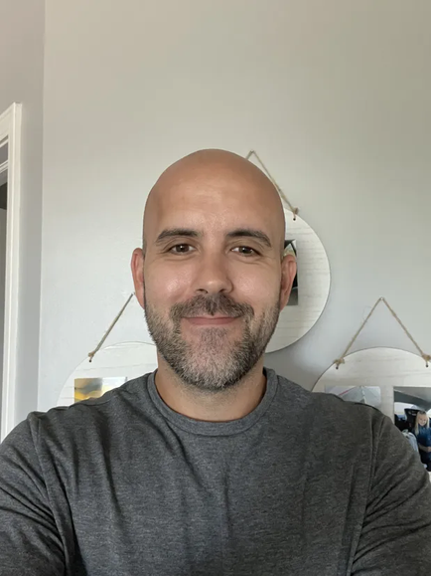
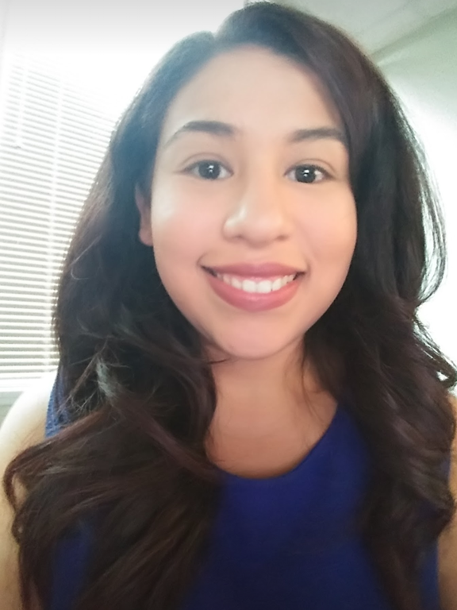

MEET TEAM BRAVO
Jacob Ambrose
Marshall Huckins
John Martino
Jackie Scott

Slide 3


Case Study
WILLSON FINANCIAL
Willson Financial was started by Jake and Ned Willson. Two college graduates with finance degrees. When Jake and Ned noticed the need for financial management services in their small town, they decided to open Willson Financial.
As the demand for Willson Financial grew, so did the business. Jake and Ned made sure they both obtained their CFA licenses and registered with the SEC. They also hired additional staff to ensure that Willson Financial followed all regulations set by the SEC. The duo also hired a third party to help manage office things such as client appointments, office supplies, and other business needs.
Willson Financial has grown sufficiently since opening its doors, which has led the team to step back to evaluate the company. Jake and Ned want to evaluate:
Their client base
The amount of assets managed by their firm.
What is their trending growth in terms of customer retention, average assets managed, and customer growth.

Slide 4
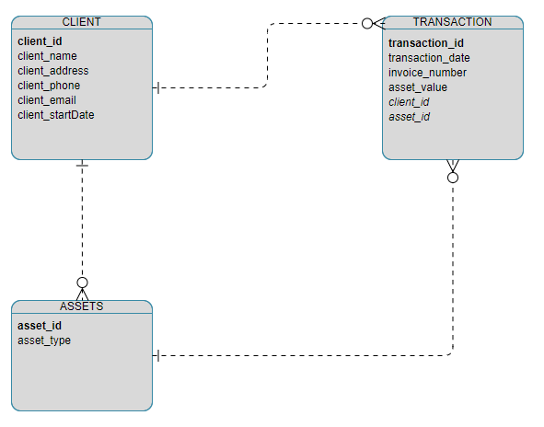
WILLSON FINANCIAL
ERD
Willson Financials' database contains three tables, Clients, Assets, and Transactions.
For the Client table, we needed to have important, searchable information for each client such as their ID number, their name, phone number as well as when they started using Willson’s services.
Our Transaction table needed to be linked to both of our Client table and our Assets table. To do this we set our client_id and asset_id as Foreign Keys. The Transaction table uses the transaction_id as the Primary Key.

Slide 5
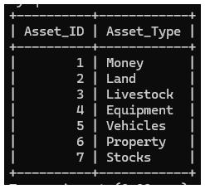
ASSETS TABLE

Slide 6
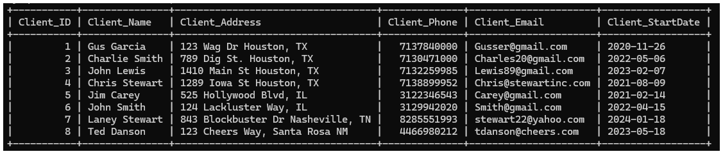
CLIENTS TABLE

Slide 7
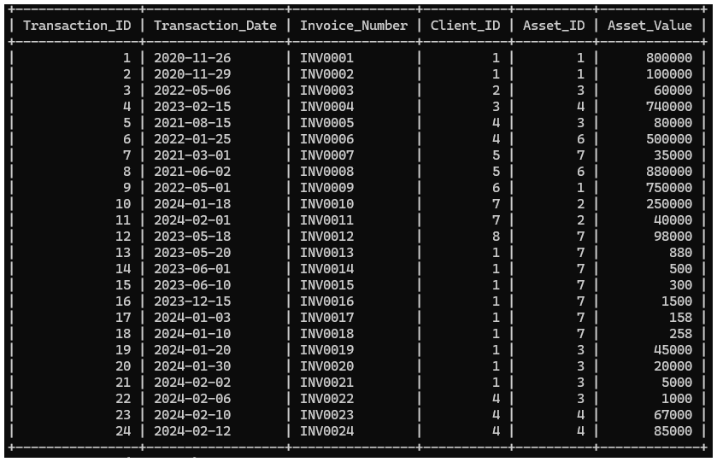
TRANSACTIONS TABLE

Slide 8




REPORTING
Average Assets
Returning Customers
New Customers
This report will show Willson Financial the average number of assets they currently manage.
Willson Financial would like a report generated to see which of their customers have used their services 10 or more times.
To determine customer growth trends, this report will output how many new customers have joined Willson Financial in the past six months.

Slide 9
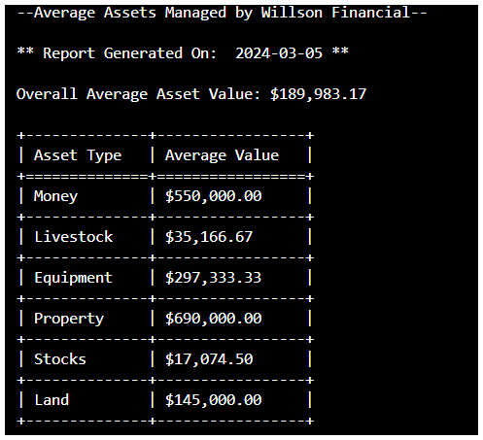
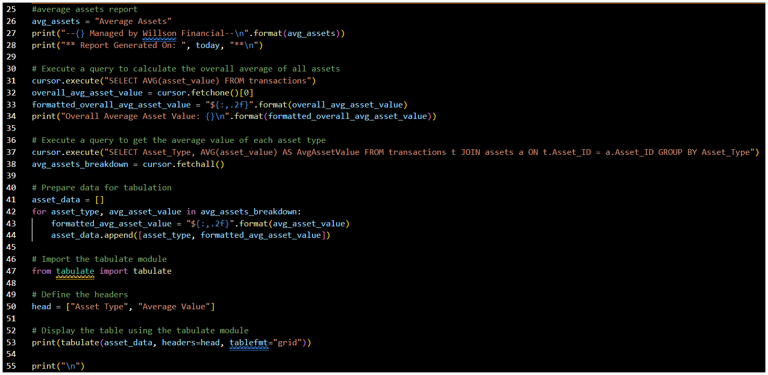
Average Assets
This report will show Willson Financial the average number of assets they currently manage.
To answer their question, “What is the average amount of assets (in currency) for the entire client list? “
Output
Python Glance
Willson Financial manages a total average of $189,98.17 in various assets. The graph shows the average for each asset type managed by the company.

Slide 10
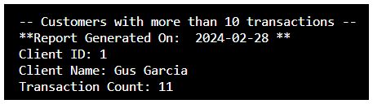
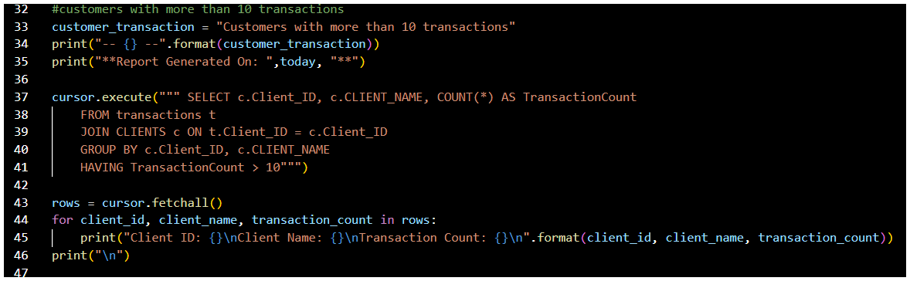
RETURNING CUSTOMERS
Willson Financial would like a report generated to see which of their customers have used their services 10 or more times.
OUTPUT
Gus Garcia has been Willson Financials’ best customer with 11 total transactions.
Python Glance

Slide 11
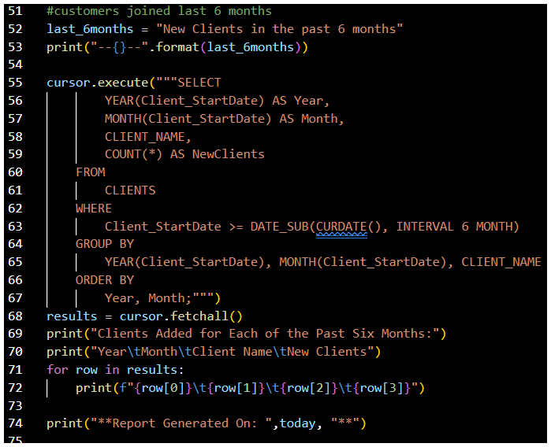
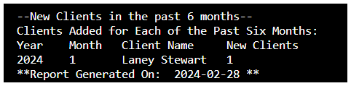
New Customers
To determine customer growth trends, this report will output how many new customers have joined Willson Financial in the past six months. To answer Willson Financials’ question, “How many clients have been added for each of the past six months? “
Python Glance
Output
In the last six months, Willson Financial has only added one new client which was, Laney Stewart in Janurary 2024.

Slide 12

ASSUMPTIONS
01
They only have one location because they returned to their small town in New Mexico.
02
They keep track of not just tangible money but also assets like land.
03
They already have a billing structure in place.
04
They document how long someone has been a customer.
05
Willson Financial has been an established company for several years.

Slide 13

BUSINESS RULES
01
Track the number of clients added each month to monitor company growth.
02
Calculate the average amount of assets managed by the company.
03
Identify clients who have more than ten transactions.
04
Every transaction will require one invoice.

Slide 14


Thank
You

